Slide 1

Lesson 10: Advanced RecyclerView use cases

Slide 2
About this lesson
Lesson 10: Advanced RecyclerView use cases
RecyclerView recap
Advanced binding
Multiple item view types
Headers
Grid layout
Summary

Slide 3
RecyclerView recap

Slide 4
RecyclerView overview
Widget for displaying lists of data
"Recycles" (reuses) item views to make scrolling more performant
Can specify a list item layout for each item in the dataset
Supports animations and transitions
Notes:
Let's briefly recap what we learned about RecyclerView in lesson 5.

Slide 5
View recycling in RecyclerView
Boston, Massachusetts
If item is scrolled offscreen, it isn’t destroyed. Item is put in a pool to be recycled.
Chicago, Illinois
Mountain View, California
Miami, Florida
Seattle, Washington
Reno, Nevada
onBindViewHolder binds the view with the new values, and then the view gets reinserted in the list.
Nashville, Tennessee
Little Rock, Arkansas
Notes:
In lesson 5, we learned that a custom adapter extends from RecyclerView.Adapter and overrides three functions:
getItemCount
onCreateViewHolder
onBindViewHolder
A ViewHolder represents a single list item view and has references to all the views within that layout.
As the diagram shows, when you have a large number of items in your list (greater than the amount of space on screen to display them all), we don’t need to create item views that have not been scrolled to yet.
The adapter’s onCreateViewHolder() method is called to create view holders for the number of items that can be displayed on the screen at one time. After that initial creation, when you scroll, the system removes offscreen list item views from the hierarchy, and calls onBindViewHolder() on the adapter to “recycle” the list item views and use them again. The values within view are updated to reflect the data in the new list item (that’s about to appear on screen). Then the list item view is added back to the view hierarchy.
Resources:
RecyclerView.Adapter
RecyclerView.ViewHolder

Slide 6
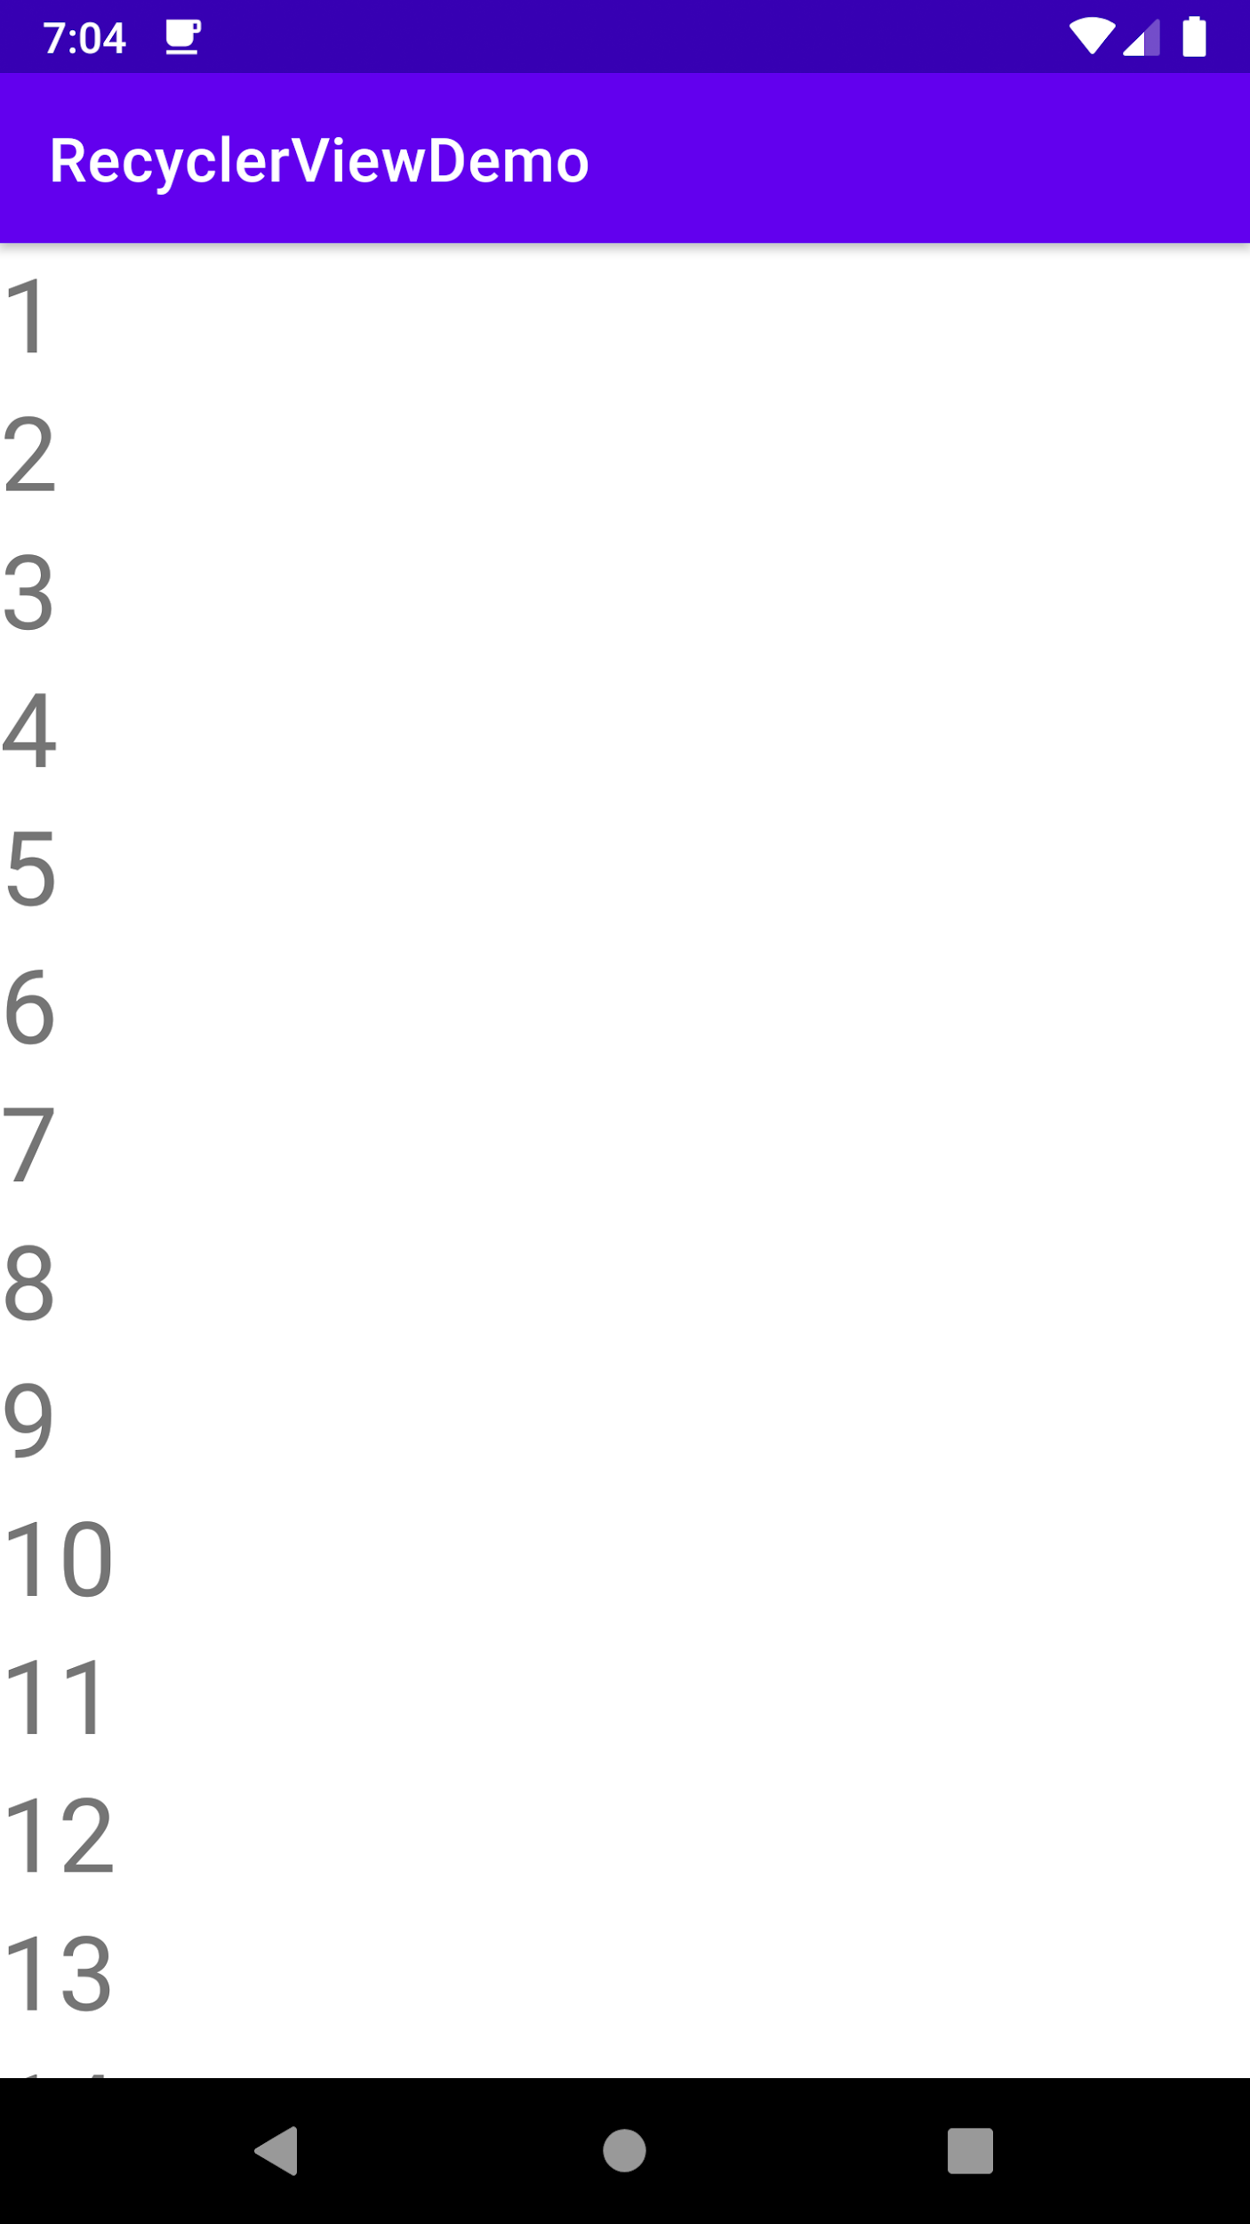
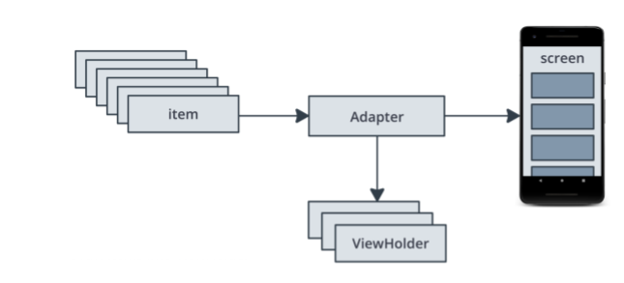
RecyclerViewDemo app
1
2
3
4
5
6
7
8
9
10
11
12
13
Notes:
In this lesson, we’ll be talking about the RecyclerViewDemo sample app. It uses a RecyclerView to display a list of numbers, and has a RecyclerView.Adapter that uses a list of integers as the source data to create item views for the list.
A list item layout contains a TextView, and we use a ViewHolder to hold a reference to that View. A ViewHolder makes it easier to update the TextView when we recycle the views, as the user scrolls the list.

Slide 7
Adapter for RecyclerViewDemo
class NumberListAdapter(var data: List<Int>):
RecyclerView.Adapter<NumberListAdapter.IntViewHolder>() {
class IntViewHolder(val row: View): RecyclerView.ViewHolder(row) {
val textView = row.findViewById<TextView>(R.id.number)
}
Notes:
Here’s the adapter code with an inner ViewHolder class.

Slide 8
Functions for RecyclerViewDemo
override fun onCreateViewHolder(parent: ViewGroup, viewType: Int): IntViewHolder {
val layout = LayoutInflater.from(parent.context) .inflate(R.layout.item_view, parent, false)
return IntViewHolder(layout)
}
override fun onBindViewHolder(holder: IntViewHolder, position: Int) {
holder.textView.text = data.get(position).toString()
}
Notes:
We will override onCreateViewHolder() to inflate the layout and call our ViewHolder and onBindViewHolder() to bind the data.

Slide 9
Set the adapter onto the RecyclerView
In MainActivity.kt:
override fun onCreate(savedInstanceState: Bundle?) {
super.onCreate(savedInstanceState)
setContentView(R.layout.activity_main)
val rv: RecyclerView = findViewById(R.id.rv)
rv.layoutManager = LinearLayoutManager(this)
rv.adapter = NumberListAdapter(IntRange(0,100).toList())
}
Notes:
In the MainActivity, we setup our RecyclerView. Note that we initialize NumberListAdapter by creating a list of numbers from 0 through 100. Then we set the adapter onto the RecyclerView.

Slide 10
Make items in the list clickable
In NumberListAdapter.kt:
override fun onCreateViewHolder(parent: ViewGroup, viewType: Int): IntViewHolder{ val layout = LayoutInflater.from(parent.context).inflate(R.layout.item_view, parent, false)
val holder = IntViewHolder(layout)
holder.row.setOnClickListener {
// Do something on click
}
return holder
}
Notes:
Just like any other view, we can add click listeners to an entire list item view or child view within it. Because our view holders get recycled, we only need to set up click listeners once when the ViewHolder is created, not when it's bound (or re-bound). When an item is clicked, we can do something like pop up a Toast message with the value from the TextView.

Slide 11
ListAdapter
RecyclerView.Adapter
Disposes UI data on every update
Can be costly and wasteful
ListAdapter
Computes the difference between what is currently shown and what needs to be shown
Changes are calculated on a background thread
Notes:
For your custom adapter, you can extend RecyclerView.Adapter directly, but whenever an update to the source data is needed, we discard the whole data list and reconstruct it. This is costly and wasteful. Especially if the prior source of data and updated source of data are the same or nearly the same. Instead, consider using ListAdapter.

Slide 12
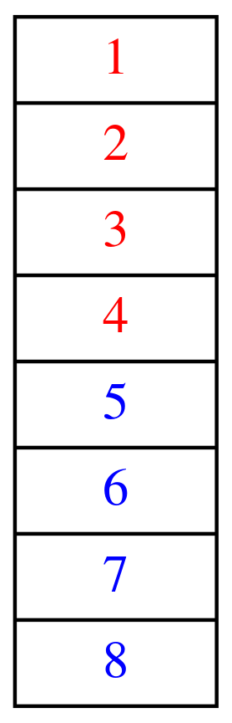
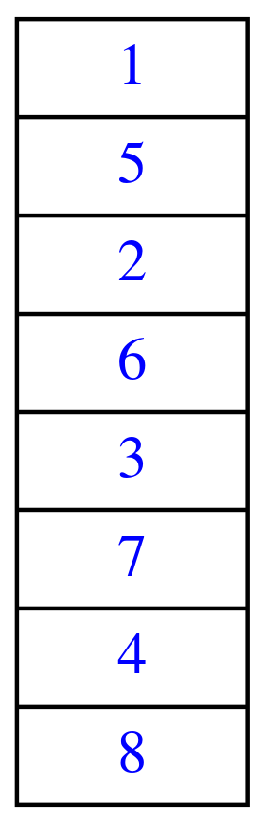
Sort using RecyclerView.Adapter
Starting state
Ending state
1
1
1
5
2
2
2
3
3
6
4
4
3
5
5
8 deletions
8 insertions
16 actions:
8 deletions
8 insertions
7
6
6
4
7
7
8
8
8
Notes:
Transitions: 3 clicks
Using a RecyclerView.Adapter, if we updated this 8-item list, it would first remove all current items from the list, and then reinsert them in the desired order. That would be 16 actions, 8 to remove (red background), and 8 to add (green background).

Slide 13
Sort using ListAdapter
1
Starting state
Ending state
5
1
1
2
5
6
2
2
3
3
6
7
4
3
3 insertions
3 deletions
4
6 actions:
3 insertions
3 deletions
5
5
7
6
6
4
7
7
8
8
8
Notes:
Transitions: 2 clicks
Instead, it's more efficient to compute the minimum insertions and deletions needed to get from the source to destination. That way, we’re not building up the list from scratch if the data hasn’t changed much.
Using ListAdapter with a diff algorithm, you can get the same ending result with only 6 actions: 3 insertions (green background) and 3 deletions (red background).

Slide 14
ListAdapter example
class NumberListAdapter: ListAdapter<Int,
NumberListAdapter.IntViewHolder>(RowItemDiffCallback()) {
class IntViewHolder(val row: View):RecyclerView.ViewHolder(row) {
val textView = row.findViewById<TextView>(R.id.number)
}
...
Notes:
There are few changes between the previous adapter code and the ListAdapter code. The first major change is the addition of the data type of the list. Instead of extending RecyclerView.Adapter<ViewHolder>, we extend ListAdapter<Int, ViewHolder>. The second change is the passing of a DiffUtil.ItemCallback object that determines how to diff two lists.

Slide 15
DiffUtil.ItemCallback
Determines the transformations needed to translate one list into another
areContentsTheSame(oldItem: T, newItem: T): Boolean
areItemsTheSame(oldItem: T, newItem: T): Boolean
Notes:
DiffUtil.ItemCallback specifies a callback for calculating the diff between two non-null items in a list. It has two abstract functions that need to be overridden: areContentsTheSame() and areItemsTheSame(). While the methods seem similar, having both gives you more control over how data is handled. For example, you may have a dataset where two list item views visually appear the same to the user, but actually represent two different things in the source data.
Resource:
ItemCallback

Slide 16
DiffUtil.ItemCallback example
class RowItemDiffCallback : DiffUtil.ItemCallback<Int>() {
override fun areItemsTheSame(oldItem: Int, newItem: Int): Boolean {
return oldItem == newItem
}
override fun areContentsTheSame(oldItem: Int, newItem: Int): Boolean {
return oldItem == newItem
}
}
Notes:
More specifically, areItemsTheSame() is called to check whether the oldItem and newItem represent the same item. For example, if your items have unique IDs, this method should check their ID equality.
areContentTheSame()is called to check whether oldItem and newItem have the same data. When DiffUtil is used with a RecyclerView.Adapter, you should return whether the two items' visual representations are the same.
Because our list is backed by a list of integers, our areItemsTheSame() and areContentsTheSame() functions have the same code.

Slide 17
Advanced binding
Notes:
In the next set of slides we'll look at how you can implement data binding with your RecyclerView adapter.

Slide 18
ViewHolders and data binding
class IntViewHolder private constructor(val binding: ItemViewBinding):
RecyclerView.ViewHolder(binding.root) {
companion object {
fun from(parent: ViewGroup): IntViewHolder {
val layoutInflater = LayoutInflater.from(parent.context)
val binding = ItemViewBinding.inflate(layoutInflater, parent, false)
return IntViewHolder(binding)
}
}
}
Notes:
Assume we’ve added data binding to the list item layout file. Now let’s look at the changes we need in our NumberListAdapter.
In Kotlin, if we want a function or property to be tied to a class rather than to instances of it, we declare it as a companion object. Inside our companion object within the IntViewHolder class, define a function named from to create the ViewHolder. We’ll use this later. The function inflates the item view using ItemViewBinding, which is a binding class auto generated from the item_view.xml layout file in our app. Next, we modify our ViewHolder code to take an ItemViewBinding object as input, and then pass in binding.root to the RecyclerView.ViewHolder superclass constructor.
Why are we passing binding as a parameter to the ViewHolder? We need it to set up binding adapters later in this lesson. Binding adapters let us encapsulate custom functionality and tie it to an attribute.
Resource:
Data Binding
Companion objects

Slide 19
Using the ViewHolder in a ListAdapter
override fun onCreateViewHolder(parent: ViewGroup, viewType: Int):
IntViewHolder {
return IntViewHolder.from(parent)
}
override fun onBindViewHolder(holder: NumberListAdapter.IntViewHolder,
position: Int) {
holder.binding.num = getItem(position)
}
Notes:
Now, in the ListAdapter, when we need to create a new ViewHolder, we can use the from helper function we created earlier (IntViewHolder.from(parent)).
When we need to bind a ViewHolder with new data, we update the num variable on the binding with the current item in the dataset. (The num variable was declared with a data tag in item_view.xml using data binding.)

Slide 20
Binding adapters
Let you map a function to an attribute in your XML
Override existing framework behavior: android:text = "foo" → TextView.setText("foo") is called
Create your own custom attributes: app:base2Number = "5" → TextView.setBase2Number("5") is called
Notes:
In previous lectures, we showed you how to use Transformations on LiveData to compute new data. We can offload some of that work to our layout XML, and create specific attributes that are evaluated at runtime.
Any attribute in a view tag can be overridden by a binding adapter. It's a way to encapsulate code to handle how something in that code gets interpreted. You can override attributes in the Android namespace or create your own attributes. You can specify the method that should be called and provide your own binding logic. Binding adapters should make the appropriate framework calls to set values on the View.

Slide 21
Custom attribute
Add another TextView in the list item layout that uses a custom attribute:
<TextView
android:id="@+id/base2_number"
android:layout_width="wrap_content"
android:layout_height="wrap_content"
android:textSize="24sp"
app:base2Number="@{num}"/>
Example list item
5
101
@id/number
@id/base2_number
Notes:
Transition: 1 click
To demonstrate this, we’ve added a second TextView (with resource ID base2_number) to the list item layout in order to display the same number, but in base 2. The full list item XML layout is not shown here, for brevity.
The diagram shows what a list item would look like if it represented the number 5. The second TextView shows its binary representation (101).
Going back to our discussion of binding adapters, we need an attribute on the View we want to modify, in this case a TextView. The custom binding goes in the app namespace so that it doesn’t conflict with any attributes provided by the framework. Note that we don’t need to specify the android:text attribute on the TextView because our binding function will do that for us when app:base2number is set.

Slide 22
Add a binding adapter
Declare binding adapter:
@BindingAdapter("base2Number")
fun TextView.setBase2Number(item: Int) {
text = Integer.toBinaryString(item)
}
In NumberListAdapter.kt:
override fun onBindViewHolder(holder: NumberListAdapter.IntViewHolder, position: Int) {
holder.binding.num = getItem(position)
holder.binding.executePendingBindings()
}
Notes:
Transition: 1 click
We declare an extension function on the TextView class as "set", followed by the name as our attribute (setBase2Number) so that Android can take advantage of automatic method selection. The method must also accept the appropriate arguments, which is Int in our example. Our setBase2Number() function directly edits the text of the TextView that called it.
We could have chosen a custom function name if desired (see Binding Adapters guide for details).
Note: Remember that extension functions let us add new functionality to a Kotlin class without inheriting from that class.
When we bind our ViewHolder, it’s good practice to call executePendingBindings(). This ensures that the framework does everything it needs to properly calculate space for the item, since changing a binding variable is not always immediate. In this snippet, where we're just calculating the base 2 value, it’s not really necessary. However, If you had a BindingAdapter that dealt with image-loading code or other time-consuming processes, it would be important to call executePendingBindings().
This is just a small example of what you can do with binding adapters.
Resources:
Binding Adapters guide
BindingAdapter class
executePendingBindings

Slide 23
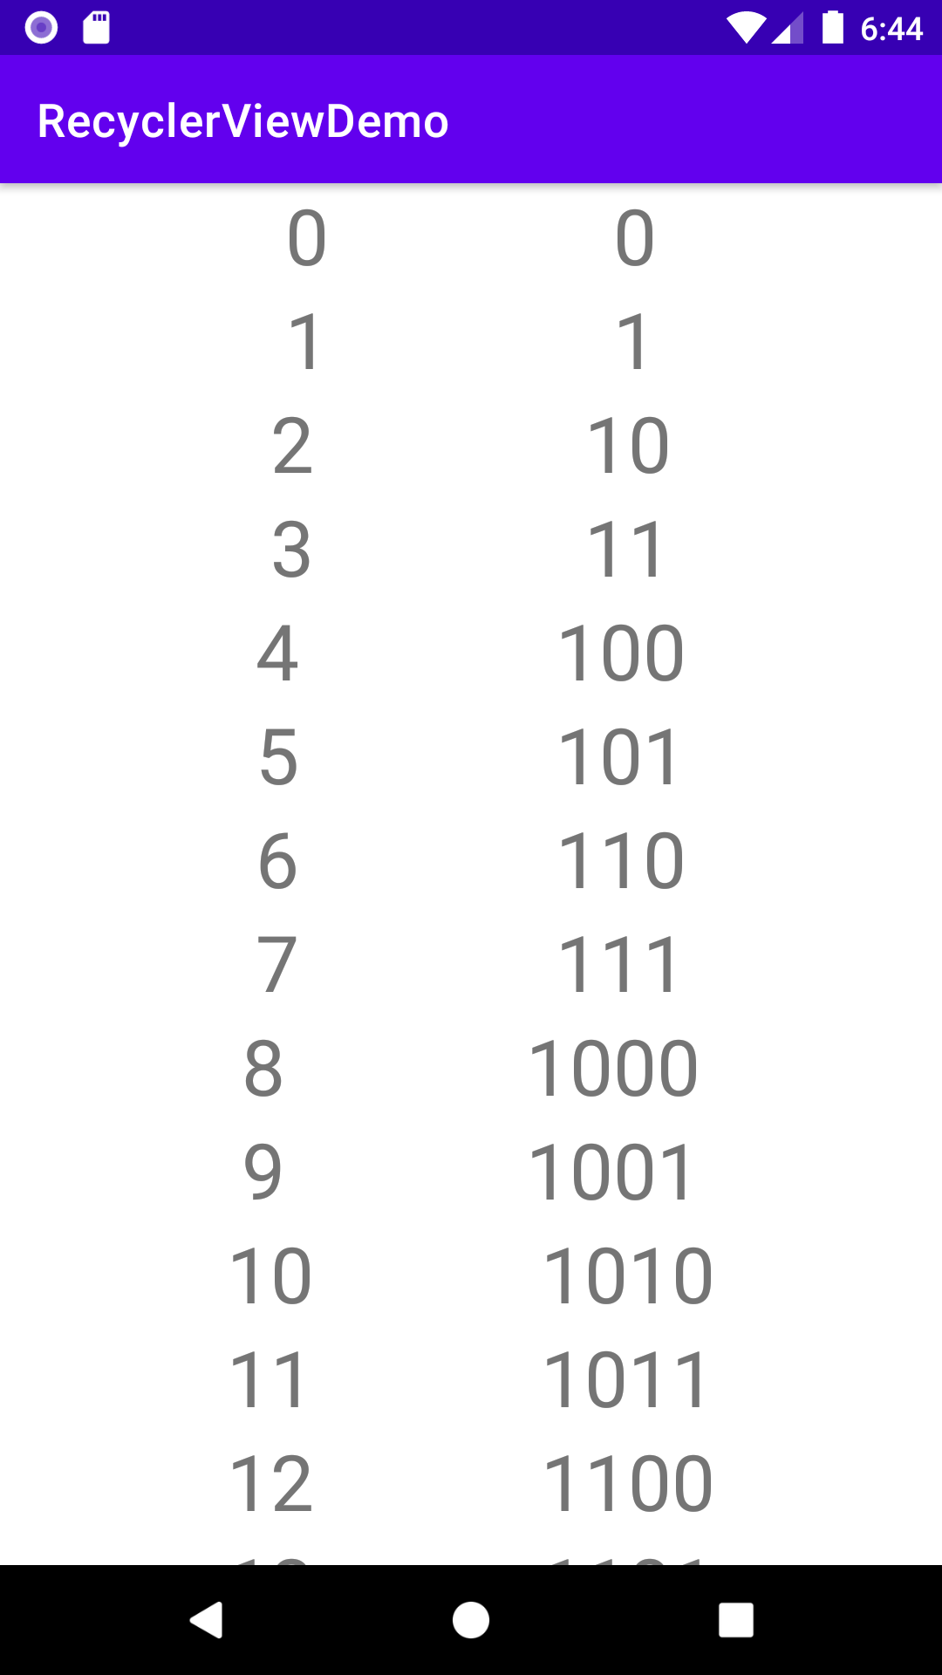
Updated RecyclerViewDemo app
Notes:
After applying the binding adapter, the app looks like this. Each list item view contains an integer number and the corresponding binary representation to the right of it.

Slide 24
Multiple item view types
Notes:
You aren’t limited to a single item view type for a RecyclerView. You can have different types of list item layouts as long as you provide the appropriate ViewHolders, and give your adapter a way to determine which ViewHolder to bind.
We’re going to expand on the last example and add an item type to show colors.

Slide 25
Add a new item view type
Create a new list item layout XML file.
Modify underlying adapter to hold the new type.
Override getItemViewType in adapter.
Create a new ViewHolder class.
Add conditional code in onCreateViewHolder and onBindViewHolder to handle the new type.
Notes:
Here are the steps needed to support another type for your RecyclerView. Many of them are steps we’ve done before, with a few modifications to existing code.

Slide 26
Declare new color item layout
<layout ...>
<data>
<variable
name="color"
type="android.graphics.Color" />
</data>
<androidx.constraintlayout.widget.ConstraintLayout ...>
<TextView
...
android:backgroundColor="@{color.toArgb()}" />
<TextView
...
android:text="@{color.toString()}" />
</androidx.constraintlayout.widget.ConstraintLayout>
</layout>
Notes:
Create a color_item_view.xml layout file for this new type of list item. Add data binding inside the layout file for the new Color variable, which we refer to in our TextViews.

Slide 27
New view type
Adapter should know about two item view types:
Item that displays a number
Item that displays a color
enum class ITEM_VIEW_TYPE { NUMBER, COLOR }
Modify getItemViewType() to return the appropriate type (as Int):
override fun getItemViewType(position: Int): Int
Notes:
The adapter should know about two item view types: an item that displays a number, and an item that displays a color. We’ve used an enum class here, but you could use immutable integers if you prefer.
Then modify the adapter’s getItemViewType() method to return the appropriate type (as an Int) based on the item at the specified position.

Slide 28
Override getItemViewType
In NumberListAdapter.kt:
override fun getItemViewType(position: Int): Int {
return when(getItem(position)) {
is Int -> ITEM_VIEW_TYPE.NUMBER.ordinal
else -> ITEM_VIEW_TYPE.COLOR.ordinal
}
}
Notes:
This code looks at the data at a given position and returns an integer indicating the view type to use.

Slide 29
Define new ViewHolder
class ColorViewHolder private constructor(val binding: ColorItemViewBinding): RecyclerView.ViewHolder(binding.root) {
companion object {
fun from(parent: ViewGroup): ColorViewHolder {
val layoutInflater = LayoutInflater.from(parent.context)
val binding = ColorItemViewBinding.inflate(layoutInflater, parent, false)
return ColorViewHolder(binding)
}
}
}
Notes:
Since we defined a new layout file called color_item_view.xml and enabled data binding in our app, the ColorItemViewBinding class will be auto-generated. Use ColorItemViewBinding to inflate the color list item view. We should also define a new ColorViewHolder for the color item view type.

Slide 30
Update onCreateViewHolder()
override fun onCreateViewHolder(parent: ViewGroup, viewType: Int):
RecyclerView.ViewHolder {
return when(viewType) {
ITEM_VIEW_TYPE.NUMBER.ordinal -> IntViewHolder.from(parent)
else -> ColorViewHolder.from(parent)
}
}
Notes:
In onCreateViewHolder(), we inspect the view type and create the appropriate ViewHolder.

Slide 31
Update onBindViewHolder()
override fun onBindViewHolder(holder: RecyclerView.ViewHolder, position: Int) {
when (holder) {
is IntViewHolder -> {
holder.binding.num = getItem(position) as Int
holder.binding.executePendingBindings()
}
is ColorViewHolder -> {
holder.binding.color = getItem(position) as Color
holder.binding.executePendingBindings()
}
}
}
Notes:
In onBindViewHolder() we use the class type of the ViewHolder to set the variables exposed in the binding, and then call executePendingBindings() to make sure the size information is up to date.
Resource:
executePendingBindings

Slide 32
Headers
Notes:
A header is a great use case for why you may want to have multiple item view types. Sometimes you may want to add a header to the list of items in a RecyclerView. Or you may want to separate list items into different groups with multiple headers. Let’s look at an example.

Slide 33
Headers Example
2 item view types:
header item
food menu item
Entrees
Burger
$5.00
$3.00
Salad
Drinks
$4.00
Sandwich
Drinks
Coffee
$2.00
Coffee
$2.00
Soda
$1.00
Notes:
In this example, the RecyclerView is showing a list of food menu options with headers distinguishing the category of food. There are 2 item view types in this RecyclerView. A header view is made up of an ImageView and a TextView. Meanwhile, a food menu item view is made up of two TextViews displaying the name of the item and its price.
The views still get recycled, but it’s important what type of view holder is required at each position. Header views only get reused at positions that require a header view, while food menu item views will only get reused at positions that require a food menu item.
When implementing headers in a RecyclerView, you could either have the headers represented in the underlying data set (e.g. 0th item in the underlying data set is the Entrees category). Or you could implement logic in the adapter to return a different view holder at certain indices (e.g. index 0), and then displaying the rest of the list items based on that offset (so the Burger menu item is still in position 0 in the underlying dataset, but it ends up getting displayed at position 1 in the RecyclerView). The latter option could get a little tricky to manage the offsets if you start to have multiple headers in your list.
Either way, being able to display headers in your list is useful to know as you display more complex lists.

Slide 34
Grid layout
Notes:
Another scenario you may run into is needing to display data in a grid.

Slide 35
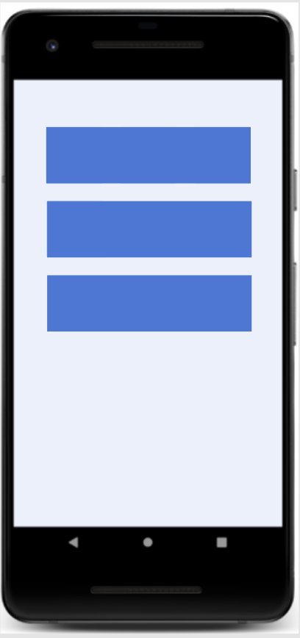
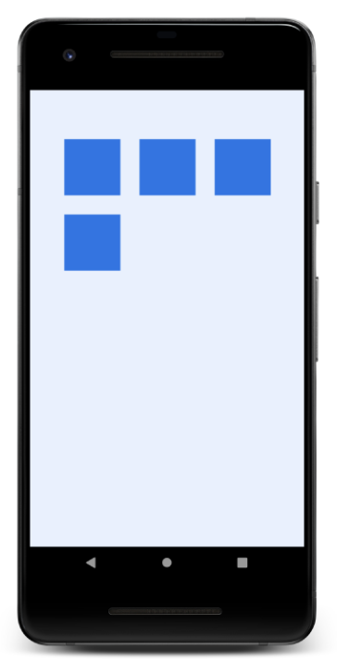
List versus grid
Notes:
So far, we’ve used RecyclerView to display a vertical list of data. The RecyclerView can also display the data in other layouts, such as a grid.

Slide 36
Specifying a LayoutManager
In MainActivity onCreate(), once you have a reference to the RecyclerView
Display a list with LinearLayoutManager:
recyclerView.layoutManager = LinearLayoutManager(this)
Display a grid with GridLayoutManager:
recyclerView.layoutManager = GridLayoutManager(this, 2)
Use a different layout manager (or create your own)
Notes:
To have the RecyclerView display the data as a grid, we just need to switch the layoutManager in our code. When initializing GridLayoutManager, the first parameter is the Context, and the second is how many items we want to fit in a single row.
Note: Although these are the most commonly used built-in layout managers, they are not the only ones.
Resource:
RecyclerView.LayoutManager

Slide 37
GridLayoutManager
Arranges items in a grid as a table of rows and columns.
Orientation can be vertically or horizontally scrollable.
By default, each item occupies 1 span.
You can vary the number of spans an item takes up (span size).
Notes:
GridLayoutManager lays out items in a grid as a table of rows and columns. Orientation can be vertically or horizontally scrollable. By default, each item occupies 1 span, but you can vary the number of spans an item takes by providing a custom SpanSizeLookup instance.
Assuming all elements are the same item type, you can derive the number of available spans by taking the available dps in the specified dimension, and divide by the item size + the layout constraints along that dimension.
Resource:
GridLayoutManager

Slide 38
Set span size for an item
Create SpanSizeLookup instance and override getSpanSize(position):
val manager = GridLayoutManager(this, 2)
manager.spanSizeLookup = object : GridLayoutManager.SpanSizeLookup() {
override fun getSpanSize(position: Int): Int {
return when (position) {
0,1,2 -> 2
else -> 1
}
}
}
Notes:
GridLayoutManager lets you determine how many spans an item takes up by providing a custom SpanSizeLookup instance, and overriding getSpanSize(position) to specify the number of spans an item at a given position takes up. Using getSpanSize() is especially important when using GridLayoutManager.
Note that the layout manager can only use position in the dataset to determine the span size (e.g., every other item has span size of X, or every nth item is span size of Y).
The code in the example sets the span size for the first 3 elements to 2 and everything else to 1.
Resource:
SpanSizeLookup

Slide 39
Summary

Slide 40
Summary
In Lesson 10, you learned how to:
Use ListAdapter to make RecyclerView more efficient at updating lists
Create a binding adapter with custom logic to set View values from an XML attribute
Handle multiple ViewHolders in the same RecyclerView to show multiple item types
Use GridLayoutManager to display items as a grid
Specify span size for an item in a grid with SpanSizeLookup

Slide 41
Learn More
Create a List with RecyclerView
RecyclerView
ListAdapter
Binding adapters
GridLayoutManager
DiffUtil and ItemCallback

Slide 42

Pathway
Practice what you’ve learned by completing the pathway:
Lesson 10: Advanced RecyclerView use cases

